Slide 1
PowerShell Security
Fred

Slide 2
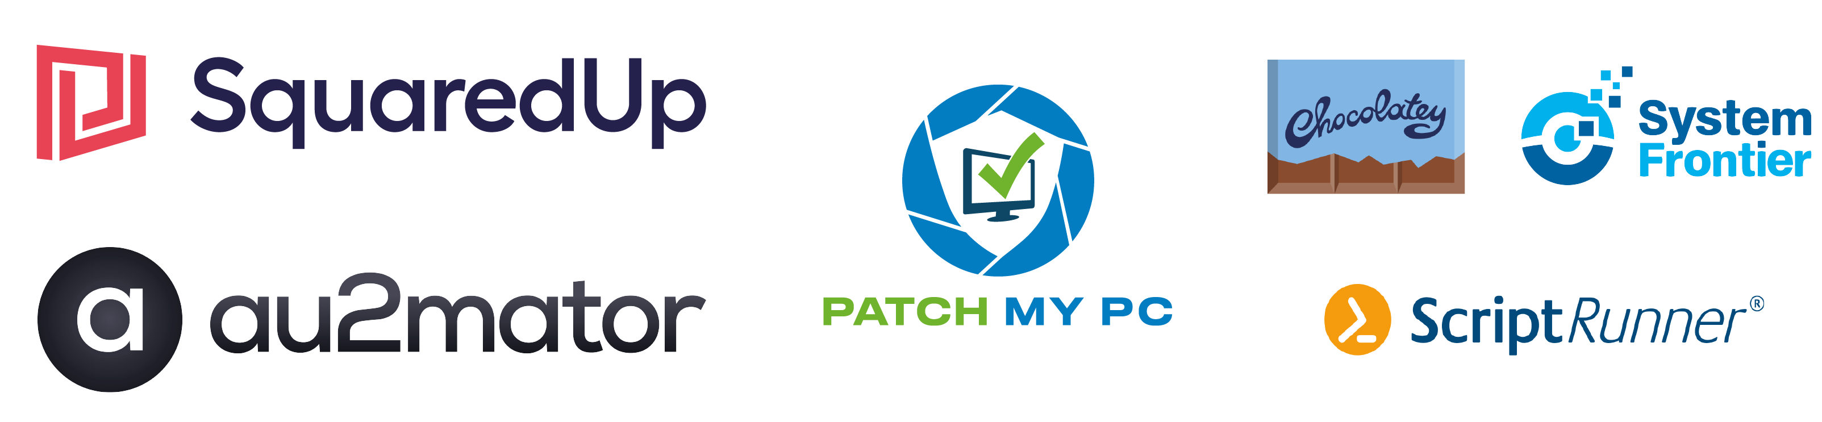
Many thanks to our sponsors:

Slide 3

about_speaker
Name: Fred
Customer Engineer @MSFT
GitHub: github.com/FriedrichWeinmann
Twitter: @FredWeinmann
PS Discord / PS Slack: Fred
Projects: PSFramework.org | admf.one
Notes:
Get the story rolling!

Slide 4
"I want to disable Power(S)hell!"

Slide 5
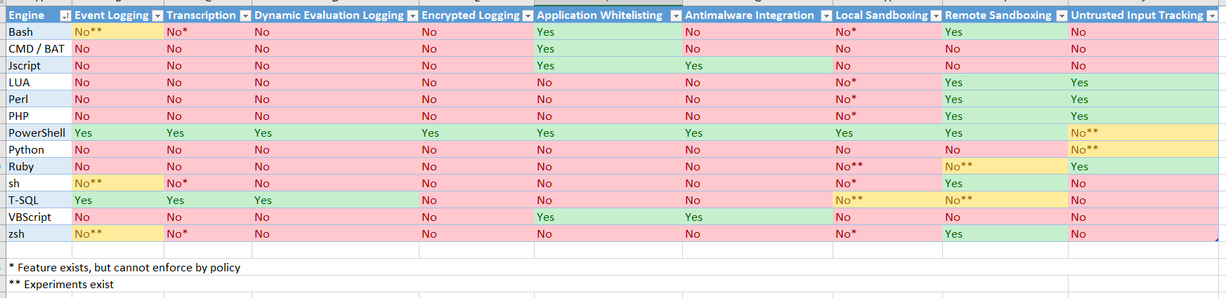
Security Features – A comparison

Slide 6


Disabling PowerShell
Not
Supported

Slide 7
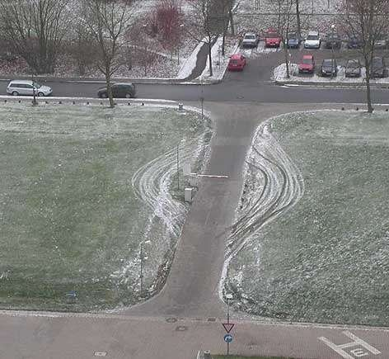
The protective (lack of) value of: Execution Policy
Notes:
Execution Policy is a file-based approach, PowerShell code can be provided in other manners.
Execution Policy is not a security feature!!
https://blog.netspi.com/15-ways-to-bypass-the-powershell-execution-policy/

Slide 8
What then?
Manage Windows PowerShell Version
5.1 Across the board
Prevent execution of older versions
Control Code Execution
Harden Remoting
Deploy Logging

Slide 9
Manage (Windows) PowerShell version

Slide 10
Windows Management Framework 5.1
Already installed on Windows 10 / Server 2016 or later
Update on:
Server 2012 R2
Server 2012
Server 2008 R2
Windows 8.1
Windows 7
Not available for:
Windows 8
Notes:
For preventing older PowerShell versions, see "Control Code Execution" Demo
Update not Supported: Exchange 2016 on Server 2012 R2
Preventing legacy versions not supported on SQL Server

Slide 11
PowerShell 7.2+
Integration into Microsoft Update
But only for x64 (for now)

Slide 12
Control Code Execution

Slide 13
The Application Whitelisting Dilemma
powershell.exe
notepad.exe
pwsh.exe

Slide 14
Extra Challenge
PowerShell code is not file-bound
Type / paste into console
Start parameter (-Command / -EncodedCommand)
Invoked from other .NET application
File-based blocking questionable
Anti-Virus equally challenged

Slide 15

Anti Malware Scan interface
All code is submitted by ENGINE
Anti-Virus software validates and can deny execution
Requires:
Windows 10 / Server 2016 or later
Anti-Virus software that supports this
Notes:
There is no definitive list of supporting Anti-Virus vendors / softwares

Slide 16

AppLocker & PowerShell
Detects AppLocker Whitelist Policy
Enables Constrained Language Mode for the process
Essential for AppLocker
Notes:
PowerShell can do anything Windows can.
Application Whitelisting that does not consider PowerShell is pointless, as any attacker can run anything using it.
To lock down PowerShell suitably, it is not enough to block a specific script file:
Script files in the temp directory of the current user need to be blocked in order to enforce Constrained Language Mode (see next slide)

Slide 17
Constrained Language Mode
All Code is affected, no matter the source
Exempt: Explicitly whitelisted scriptfiles / modules
Restricts available tools
.NET methods unavailable*
.NET objects read-only
Commands may require trusted input
No PowerShell Classes or Add-Type
…
No Wildcard export in modules
Notes:
Constrained Language Mode (CLM) enforces strict rules and reduces the available set of tools to:
Most default PowerShell cmdlets
Basic type system access only
This prevents direct access to windows APIs and breaks more than 99% of all known malware using PowerShell
Code explicitly exempted (e.g. signed by a trusted code signing certificate with a publisher whitelist rule) is not subject to CLM, even though the console may be.
More on CLM: https://devblogs.microsoft.com/powershell/powershell-constrained-language-mode/

Slide 18
Demo

Slide 19
Harden Remoting

Slide 20
Remoting Options
Server / Client Separated
Where to accept sessions from
Authentication
Network Connection settings
Notes:
The first step is to lock down and secure, how you can use PowerShell Remoting.
You can configure from where the WinRM service will accept connections in two locations:
Firewall
WinRM Service
You can pick whichever works better for you, but generally it's more reliable in the WinRM service.
You can further configure connection parameters and supported authentication for WinRM, both client-side as well as server-side.
Use common sense for most, but:
Disabling Basic Authentication for the client prevents connecting to Exchange Online and Security & Compliance Center with PowerShell, as Modern Authentication looks to WinRM the same as Basic auth
Enforcing Encrypted connections as misleading. All PowerShell Remoting sessions are encrypted! But by default they use http and use package level encryption. Forcing transport level encryption with this setting requires rolling out suitable certificates

Slide 21
Demo

Slide 22
PowerShell integrated Logging

Slide 23

Transcript
Logging
Module
ScriptBlock
Notes:
PowerShell supports three separate logging mechanisms, each can be configured per GPO:
Module Logging: Functionally superceded, no need not use
Transcript Logging: Full text log of commands and output. No logrotate included, beware of data privacy concerns, as well as leaking sensitive data or secrets.
ScriptBlock Logging: Logs all code executed to eventlog. Can be logged encrypted

Slide 24
Demo

Slide 25
The Others
Implement "Release" process & code signing for internal code
Implement approval process for public code
Use PowerShell for secure delegation using: Just Enough Administration (JEA)

Slide 26
Roadmap to securing PowerShell
Deploy Secure Remoting
Only allow remoting from administrative subnet
Ensure authentication protocols
AppLocker
Usermode
Affect only non-admin processes
Path whitelist for ProgramFiles and System32 modules
Logging
Enable Scriptblock logging
Aggregation and analytics
Secure Code Management
Internal repository, signed code
Approval process for external modules
Application Whitelisting
Only allow internally signed code
Period. Dot. No Exceptions.
Notes:
Parallel to first step: Get admins to use source control for their scripts

Slide 27
Q&A
15 minutes

Slide 28
Microsoft Graph is the large new modern API to access Microsoft 365 data. Developing with Graph can be fun, but like every API it requires actions to make a script or program secure. This sessions shows common mistakes and gives tipps how to secure your own Graph API PS Script. It will cover topics like permission models, CBA, CA, scoping and more.

Slide 29
Slide title
Sample text for your PSConf.EU 2022 presentation
We usually prefer demos, use slides with moderation
Think about those at the back of the room, some text might be too small.
Think about accessibility, try to improve the contrast, colours and size of your presentation.

Slide 30
Instructions
Use this template if you want, it’s preferred but not mandatory.
Please make sure our sponsors are mentioned on your first slide after the title.
Do not amend the ratio or the colours of the sponsors’ logo and background.
Update your twitter handle through the master page (see next slides).

Slide 31
Instruction (Continued)
The session is 30 min.
Then 15min Q&A.
At the end of your 45 min, please leave the room to the next speaker.
You’re welcome to continue the discussion in the Foyer area.

Slide 32
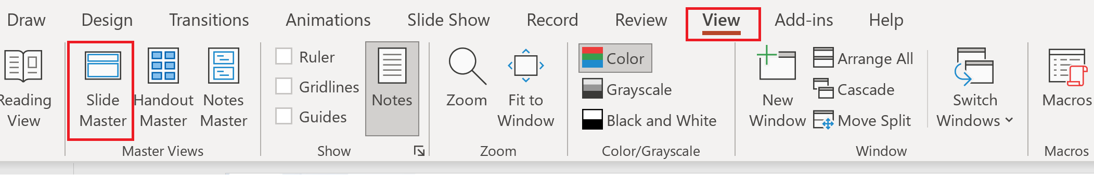
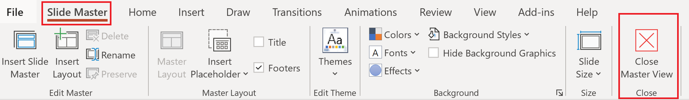
Update the twitter handle on the master slide
To open the slide master:
To close the Master view:
If you need any help, do not hesitate to email us at psconfeu@synedgy.com

Slide 33
Demos
We love Demos!

Slide 34
Q&A
15 minutes

